Slide 1


GOOGLE MATERIAL UI
Notes:
Add instructor notes here.

Slide 2
Lesson Objectives
At the end of this module on React fundamentals you will be able to:
Explain and demonstrate
Installing Material UI
Material UI AppBar
Material UI's Toolbar
Custom React NavBar CSS
Material UI Buttons
Using Material UI - Rendering a Button
Material UI Card
Material UI Checkbox
Material UI Grid Component
Material UI IconButton
Material UI Paper Component
Style Material UI Components with my own CSS
UI Templates for Business
Typography Usage
Notes:
Add instructor notes here.

Slide 3
MATERIAL-UI
React components for faster and easier web development.
Build your own design system or start with Material Design.
Material-UI is an MIT-licensed open-source project.
What is MIT License?
The MIT License is a permissive free software license originating at the Massachusetts Institute of Technology in the late 1980s.
As a permissive license, it puts only very limited restriction on reuse and has, therefore, high license compatibility.
It's business friendly and open source friendly.
Notes:
In the traditional HTML form elements, the state of the elements will change with the user input.
React uses a declarative approach to describe the UI. The input needs to be dynamic to reflect the state properly.
render() { return <input type="text" name=“compName" value=“capgemini" /> }
The code above represents the view at any state, and the value will always be “capgemini”.
With input fields, they must change in response to the user keystrokes. Given these points, let’s make the value dynamic.
render() { return <input type="text" name="title" value={this.state.title} /> }
Developers need to implement an event handler to capture changes with onChange.
The best practice is for developers to implement the following things to sync the internal state with the view
Controlled Components
In normal HTML form, it has the default behavior of browsing to a new page when the user submits the form. Same behavior is also available in React. But in most cases, what if a JavaScript function that handles the submission of the form and has access to the data that the user entered into the form. The standard way to achieve this is with a technique called “controlled components”.
In HTML Form elements like <input>, <textarea>, and <select> have their own state and updates based on user input.
But in React, mutable state is typically kept in the state property of components, and only updated with setState().
Slide explains that communication between service provider and consumer happen via SOAP messages

Slide 4
MATERIAL-UI
Material-UI components work in isolation.
They are self-supporting, and will inject, and only inject, the styles they need to display.
They don't rely on any global style-sheets such as normalize.css.
It's an independent project with ongoing development.
Notes:
Any submit or button click is triggered in the form will trigger handleClick
handleClick=()=>{
this.setState({
displayValue:this.state.value.toUpperCase(),
value:''
});
}
For creating react <select> ie., Drop down:
<select value={this.state.value} onChange={this.handleChange}>
<option value="grapefruit">Grapefruit</option>
<option value="lime">Lime</option>
<option value="coconut">Coconut</option>
<option value="mango">Mango</option>
</select>
Slide explains about WSDL and UDDI registry.
Also explains regarding web service communication

Slide 5





Who's using Material UI
NASA
Walmart Labs
Capgemini
UNI QLO
Bethesda
Notes:
You've got three options
Add a constructor and do the binding there (recommended):
this.handleSubmit = this.handleSubmit.bind(this);
Bind directly:
onSubmit={this.handleSubmit.bind(this)}
Use arrow => functions
onSubmit={() => this.handleSubmit}
handleFormSubmit(e) {
e.preventDefault();
let userData = this.state.newUser;
alert("you typed : "+JSON.stringify(userData));
console.log("Successful " + userData);
}

Slide 6
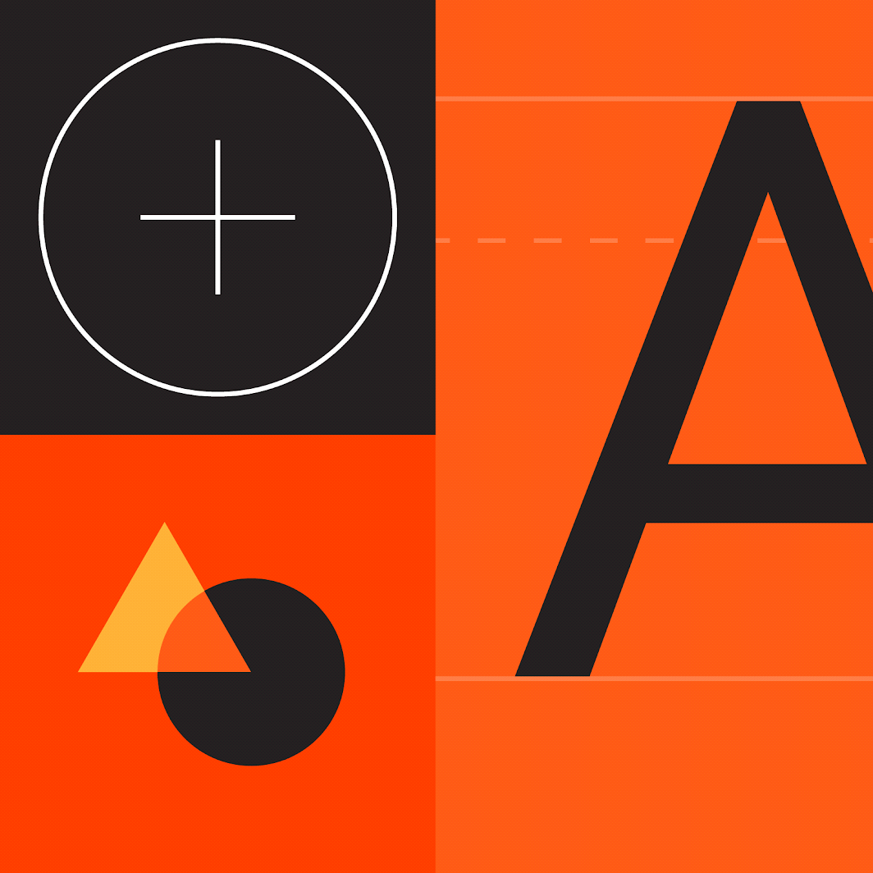
Material Design
Material is a design system created by Google to help teams build high-quality digital experiences for Android, iOS, Flutter, and the web.
Material Design is inspired by the physical world and its textures, including how they reflect light and cast shadows.
Material Design is guided by print design methods — typography, grids, space, scale, color, and imagery — to create hierarchy, meaning, and focus that immerse viewers in the experience.

Slide 7
Typography
Typography is the art of arranging letters and text in a way that makes the copy legible, clear, and visually appealing to the reader.
The Material Design type scale provides 13 typography styles for everything from headlines to body text and captions.
Each style has a clear meaning and intended application within an interface.
Important attributes, such as the typeface, font weight, and letter case, can be modified to match your brand and design.

Slide 8
Shape
Applying shape styles can help direct attention or identify components, communicate their state, and express your brand.
Components that need to stand out can also use shapes that express your brand.
The color, typography, and shape of Material Components like buttons can be easily modified to match your brand.

Slide 9
Material Component
Material Components are interactive building blocks for creating a user interface, and include a built-in states system to communicate focus, selection, activation, error,
hover, press, drag, and disabled states.
Component libraries are available for Android, iOS, Flutter, and the web.
Installation :
To install and save in your package.json dependencies, run:
npm install @material-ui/core
Please note that react >= 16.3.0 and react-dom >= 16.3.0 are peer dependencies

Slide 10
Roboto Font
Material-UI was designed with the Roboto font in mind.
The Roboto font will not be automatically loaded by Material-UI.
The developer is responsible for loading all fonts used in their application.
Roboto Font has a few easy ways to get started.
For instance, via Google Web Fonts:
<link rel="stylesheet“
href="https://fonts.googleapis.com/css? family=Roboto:300,400,500">

Slide 11
Install and Import Roboto
To Install using npm:
npm install typeface-roboto --save
Then, you can import it in your entry-point.
import 'typeface-roboto’;
Material-UI default typography configuration only relies on
300, 400 and 500 font weights.

Slide 12
APPBAR
The App Bar displays information and actions relating to the current screen.
The AppBar component in Material UI is actually just a Paper component with some special CSS properties.
It’s used for branding, screen titles, navigation, and actions.
It can transform into a contextual action bar or be used as a navbar.
By default, the AppBar's position is fixed, and the appropriate CSS positioning is set by the component (top, left, right).
You can change the position property of the AppBar by using the position prop.
The available options are the same as the CSS position values- position absolute, fixed, relative, static and sticky.
Notes:
To build ready and download: https://divjoy.com/build

Slide 13
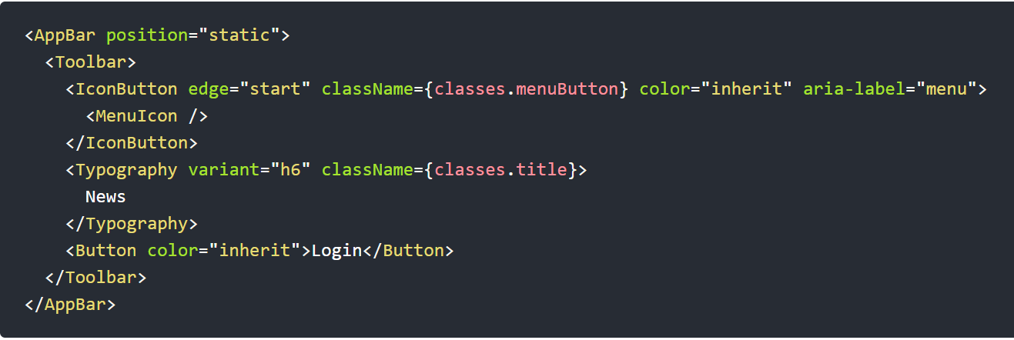
APPBAR Basic Example

Slide 14
APPBAR
Component Name | Props Used | Description
AppBar | position | The positioning type.
Toolbar | – | Toolbar
Typography | variant | Applies the theme typography styles.
Button | variant | The variant to use.
 | color | The color of the component.
Text Field | variant | The variant to use.

Slide 15
TOOLBAR
The main purpose of Toolbar is to display its children with an inline display (elements are placed next to each other)
Toolbar uses display: flex as Appbar uses, but doesn't set flex-direction, which means it uses its default value: row.
The MuiToolbar name can be used for providing default props or style, overrides at the theme level.
Toolbar will be much almost always be used in conjunction with AppBar.
You will find in all or most of demo’s that header contains 2 things.
One is AppBar and within that ToolBar will be used.

Slide 16
TOOLBAR Vs APPBAR
Appbar is totally about what it given the positioning and styling in terms of Layout to the actual header.
Toolbar is mostly about giving the structure.
Without Toolbar you will find the AppBar gets jumbled up with all items in it.
And without Appbar, you will find no Styles applied on it.
Whatever items you want in the Appbar will be placed inside the nested Toolbar.
In Appbar, you will find properties as setting the color and positioning will be taken care by this.

Slide 17
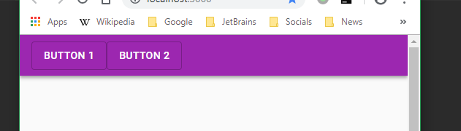
TOOLBAR Vs APPBAR
For example, we have an Appbar with a Toolbar with two Buttons as children:
<AppBar>
<Toolbar>
<Button variant="outlined" color="inherit" >
Button 1
</Button>
<Button variant="outlined" color="inherit">
Button 2
</Button>
</Toolbar>
</AppBar>

Slide 18
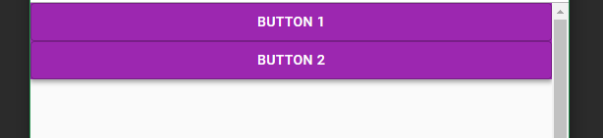
TOOLBAR Vs APPBAR
If we remove the Toolbar and place the Buttons directly under the AppBar component:
<Appbar>
<Button variant="outlined" color="inherit" >
Button 1
</Button>
<Button variant="outlined" color="inherit">
Button 2
</Button>
</AppBar>
The result will be very different as shown in next slide, because now the buttons are direct descendants of the AppBar component and so, they will be stacked on top of each other.

Slide 19
DEMO
Appbar
Toolbar

Slide 20
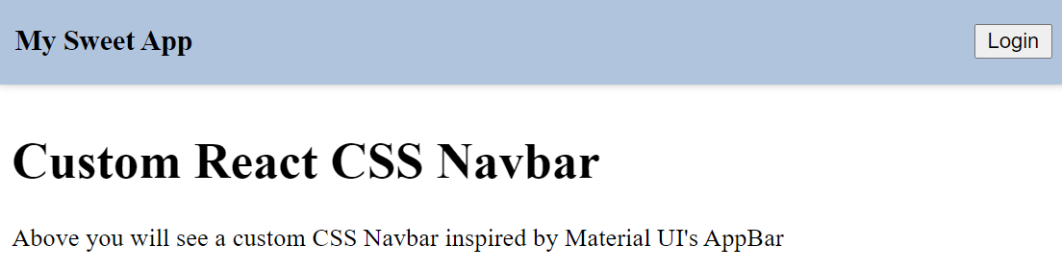
Custom React NavBar CSS
Simple implementation of their AppBar using pure React and CSS.
function App() {
return (
<div>
<header className="Navbar">
<div className="Toolbar">
<div className="Title"> My Sweet App </div>
<div>
<button> Login </button>
</div>
</div>
</header>
<div className="Toolbar" />
<h1> Custom React CSS Navbar </h1>
<p>
{" "}
Above you will see a custom CSS Navbar inspired by Material UI's AppBar.
</p>
</div>
);
}

Slide 21
DEMO
Custom React Navbar CSS

Slide 22
MATERIAL UI BUTTON
Buttons allow users to take actions, and make choices, with a single tap.
Buttons communicate actions that users can take.
They are typically placed throughout your UI, in places like:
Dialogs
Modal windows
Forms
Cards
Toolbars

Slide 23
MATERIAL UI BUTTON
Installation:
npm install @material/button
Styles:
@use “@material/button” ;
@include button.core-styles;

Slide 24
TYPES OF BUTTONS
1. Text button (low emphasis) Text buttons are typically used for less important actions. 2. Outlined Button (medium emphasis) Outlined buttons are used for more emphasis than text buttons due to the stroke. 3. Contained button (high emphasis) Contained buttons have more emphasis, as they use a color fill and shadow. 4. Toggle button Toggle buttons group a set of actions using layout and spacing. They’re used less often than other button types.

Slide 25
TYPES OF BUTTONS
Buttons contain one required element and four optional elements.
1. Text button A. Text label C. Icon (optional) 2. Outlined button A. Text label B. Container C. Icon (optional) 3. Contained button A. Text label B. Container C. Icon (optional) 4. Outlined button A. Text label C. Icon(optional)

Slide 26
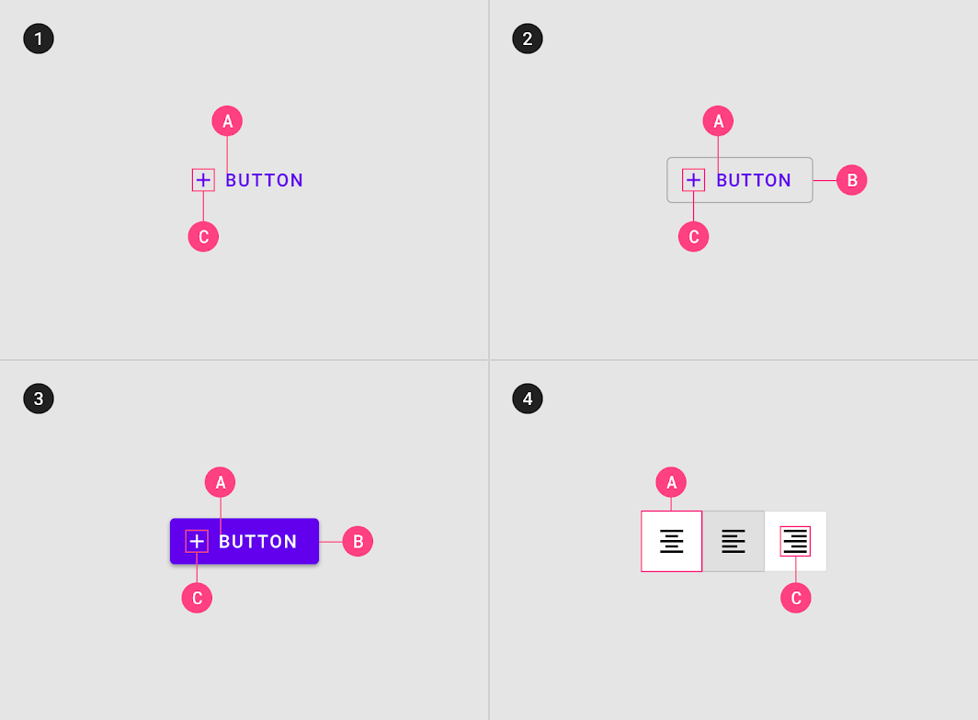
ELEMENTS OF BUTTONS

Slide 27
BUTTONS
Text Buttons
Text buttons and contained buttons use text labels, which describe the action that will occur if a user taps a button.
If a text label is not used, an icon should be present to signify what the button does.
Outlined buttons are medium-emphasis buttons. They contain actions that are important, but aren’t the primary action in an app.
Outlined buttons display a stroke around a text label. Stroke can be represented in different ways:
Set a button’s width to be the size of the text label, with 16dp padding on the left and right
Set the button’s relative position to the responsive layout grid.
In a resting state, outlined buttons should display containment with a stroke and no fill.

Slide 28
BUTTONS
Contained Buttons:
Contained buttons display a container around a text label.
Containers can be represented in different ways:
Set container width to the size of the text label with 16dp padding on the left and right
Set the container’s relative position to the responsive layout grid.
Contained buttons should display containers with a solid color.

Slide 29
DEMO ON TEXT BUTTON
import React from 'react';
import { createStyles,
makeStyles,
Theme } from '@material-ui/core/styles';
import Button from '@material-ui/core/Button';
const useStyles = makeStyles((theme: Theme) =>
createStyles({
root: {
'& > *': {
margin: theme.spacing(1),
},
},
}),
);
Notes:
import React from 'react';
import { createStyles, makeStyles, Theme } from '@material-ui/core/styles';
import Button from '@material-ui/core/Button';
const useStyles = makeStyles((theme: Theme) =>
createStyles({
root: {
'& > *': {
margin: theme.spacing(1),
},
},
}),
);
export default function TextButtons() {
const classes = useStyles();
return (
<div className={classes.root}>
<Button>Default</Button>
<Button color="primary">Primary</Button>
<Button color="secondary">Secondary</Button>
<Button disabled>Disabled</Button>
<Button href="#text-buttons" color="primary">
Link
</Button>
</div>
);
}

Slide 30
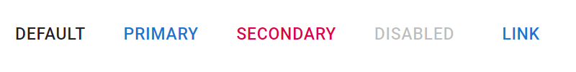
DEMO ON TEXT BUTTON
export default function TextButtons() {
const classes = useStyles();
return (
<div className={classes.root}>
<Button>Default</Button>
<Button color="primary">Primary</Button>
<Button color="secondary">Secondary</Button>
<Button disabled>Disabled</Button>
<Button href="#text-buttons" color="primary">
Link
</Button>
</div>
);
}

Slide 31
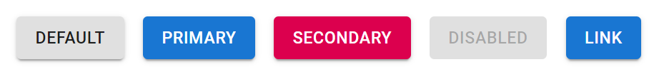
DEMO ON CONTAINED BUTTON
export default function ContainedButtons() {
const classes = useStyles();
return (
<div className={classes.root}>
<Button variant="contained">Default</Button>
<Button variant="contained" color="primary">
Primary
</Button>
<Button variant="contained" color="secondary">
Secondary
</Button>
<Button variant="contained" disabled>
Disabled
</Button>
<Button variant="contained" color="primary" href="#contained-buttons">
Link
</Button>
</div>
);
}
Notes:
import React from 'react';
import { createStyles, makeStyles, Theme } from '@material-ui/core/styles';
import Button from '@material-ui/core/Button';
const useStyles = makeStyles((theme: Theme) =>
createStyles({
root: {
'& > *': {
margin: theme.spacing(1),
},
},
}),
);
export default function TextButtons() {
const classes = useStyles();
return (
<div className={classes.root}>
<Button>Default</Button>
<Button color="primary">Primary</Button>
<Button color="secondary">Secondary</Button>
<Button disabled>Disabled</Button>
<Button href="#text-buttons" color="primary">
Link
</Button>
</div>
);
}

Slide 32
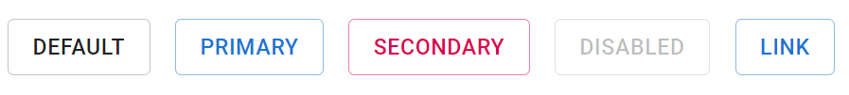
DEMO ON OUTLINED BUTTON
<Button variant="outlined">Default</Button>
<Button variant="outlined" color="primary">
Primary
</Button>
<Button variant="outlined" color="secondary">
Secondary
</Button>
<Button variant="outlined" disabled>
Disabled
</Button>
<Button variant="outlined" color="primary" href="#outlined-buttons">
Link
</Button>
Notes:
import React from 'react';
import { createStyles, makeStyles, Theme } from '@material-ui/core/styles';
import Button from '@material-ui/core/Button';
const useStyles = makeStyles((theme: Theme) =>
createStyles({
root: {
'& > *': {
margin: theme.spacing(1),
},
},
}),
);
export default function TextButtons() {
const classes = useStyles();
return (
<div className={classes.root}>
<Button>Default</Button>
<Button color="primary">Primary</Button>
<Button color="secondary">Secondary</Button>
<Button disabled>Disabled</Button>
<Button href="#text-buttons" color="primary">
Link
</Button>
</div>
);
}

Slide 33
RENDERING THE BUTTON
Using the components are simple in material UI.
Import the component from the library and render it like any other React component.
import React from 'react';
import { Button } from '@material-ui/core';
function App() {
return <Button color="primary">Hello World</Button>;
}
Good thing about component is, they all contain their own styles.
There is a theme which controls properties like spacing and the primary color palette.
In all previous button type demo’s, you would have rendered the button as rendering any other components.

Slide 34
MATERIAL UI CARD
Card contain content and actions about a single subject.
In other words, Cards are surfaces that display content and actions on a single topic.
Cards can support multiple actions, UI controls, and an overflow menu.
And cards are entry points to more complex and detailed information as well.
See the below example on Simple card

Slide 35
MATERIAL UI SIMPLE CARD
import React from 'react';
import { makeStyles } from '@material-ui/core/styles';
import Card from '@material-ui/core/Card';
import CardActions from '@material-ui/core/CardActions';
import CardContent from '@material-ui/core/CardContent';
import Button from '@material-ui/core/Button';
import Typography from '@material-ui/core/Typography';
const useStyles = makeStyles({
root: { minWidth: 275, },
bullet: { display: 'inline-block',
margin: '0 2px',
transform: 'scale(0.8)', },
title: { fontSize: 14, },
pos: { marginBottom: 12, },
});

Slide 36
MATERIAL UI SIMPLE CARD
export default function SimpleCard() {
const classes = useStyles();
const bull = <span className={classes.bullet}>-</span>;
return (
<Card className={classes.root}>
<CardContent>
<Typography className={classes.title} color="textSecondary" gutterBottom>
Session of the Day
</Typography>
<Typography variant="h5" component="h2">
Material{bull}UI{bull}React{bull}Session
</Typography>

Slide 37
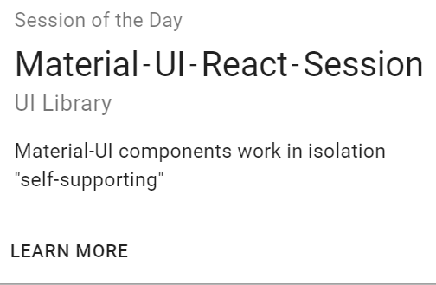
MATERIAL UI SIMPLE CARD
<Typography className={classes.pos} color="textSecondary">
UI Library
</Typography>
<Typography variant="body2" component="p">
Material-UI components work in isolation
<br />
{'"self-supporting"'}
</Typography>
</CardContent>
<CardActions>
<Button size="small">Learn More</Button>
</CardActions>
</Card>
);
}

Slide 38
MATERIAL UI CARD USING IMAGE
export default function MediaCard() {
const classes = useStyles();
return (
<Card className={classes.root}>
<CardActionArea>
<CardMedia
className={classes.media}
image="https://img.etb2bimg.com/imgv2/width-960,height- 430,resize_mode-1/retail_files/2-1503917163-prod-bnr.jpg"
title="Honda Sedan Car"
/>
<CardContent>
<Typography gutterBottom variant="h5" component="h2">
Honda Amaze
</Typography>

Slide 39
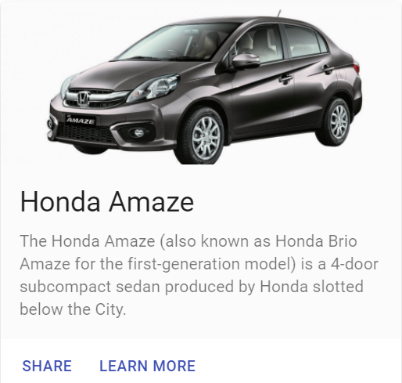
MATERIAL UI CARD USING IMAGE
<Typography variant="body2" color="textSecondary" component="p">
The Honda Amaze (also known as Honda Brio Amaze for the first-generation model) is a 4-door subcompact sedan produced by Honda slotted below the City.
</Typography>
</CardContent>
</CardActionArea>
<CardActions>
<Button size="small" color="primary">
Share
</Button>
<Button size="small" color="primary">
Learn More
</Button>
</CardActions>
</Card>
);
}

Slide 40
MATERIAL UI CHECKBOX
Material UI Checkbox works by using the browser's native input HTML element, inside of a Material UI IconButton to create the ripple and button effects.
The native checkbox input is hidden and instead a checkbox SVG icon is used.
Using the Material UI Checkbox is essentially the same as native React inputs.
You have a checked prop, a boolean set to either true or false, which determines whether the Checkbox is checked or not.
You use the onChange prop and React hooks to set and maintain the state of the checkbox.

Slide 41
MATERIAL UI CHECKBOX
In the event handler, we can look at event.target.checked to know what the new state value should be set to.
While handling multiple checkboxes, we can look at the target.name to identify which checkbox we touched and then store that as a key in our React state.

Slide 42
MATERIAL UI CHECKBOX Simple Example
import React from "react";
import Checkbox from "@material-ui/core/Checkbox";
import FormControlLabel from "@material-ui/core/FormControlLabel";
function App() {
const [checked, setChecked] = React.useState(true);
const handleChange = (event) => {
setChecked(event.target.checked);
};
return (
<FormControlLabel
control={<Checkbox checked={checked} onChange={handleChange} />}
label="Check me"
/>
);
}

Slide 43
MATERIAL UI CHECKBOX FormGroup Example
import React from 'react';
import { makeStyles, Theme, createStyles } from '@material-ui/core/styles';
import FormLabel from '@material-ui/core/FormLabel';
import FormControl from '@material-ui/core/FormControl';
import FormGroup from '@material-ui/core/FormGroup';
import FormControlLabel from '@material-ui/core/FormControlLabel';
import FormHelperText from '@material-ui/core/FormHelperText';
import Checkbox from '@material-ui/core/Checkbox';

Slide 44
MATERIAL UI CHECKBOX FormGroup Example cont…
const useStyles = makeStyles((theme: Theme) =>
createStyles({
root: {
display: 'flex',
},
formControl: {
margin: theme.spacing(3),
},
}),
);
export default function CheckboxesGroup() {
const classes = useStyles();
const [state, setState] = React.useState({
mohammed: true,
sudheer: false,
ajay: false,
});

Slide 45
MATERIAL UI CHECKBOX FormGroup Example cont…
const handleChange = (event: React.ChangeEvent<HTMLInputElement>) => {
setState({ ...state, [event.target.name]: event.target.checked });
};
const { mohammed, sudheer, ajay } = state;
const error = [mohammed, sudheer, ajay].filter((v) => v).length !== 2;
return (
<div className={classes.root}>
<FormControl component="fieldset" className={classes.formControl}>
<FormLabel component="legend">Part of JEE Team</FormLabel>

Slide 46
MATERIAL UI CHECKBOX FormGroup Example cont…
<FormGroup>
<FormControlLabel
control={<Checkbox checked={mohammed} onChange={handleChange} name="mohammed" />}
label="Mohammed Ishaque"
/>
<FormControlLabel
control={<Checkbox checked={sudheer} onChange={handleChange} name="sudheer" />}
label="Sudheer Pavan"
/>
<FormControlLabel
control={<Checkbox checked={ajay} onChange={handleChange} name="ajay" />}
label="Ajay Pulugundla"
/>
</FormGroup>
<FormHelperText>JEE LoT</FormHelperText>
</FormControl>

Slide 47
MATERIAL UI CHECKBOX FormGroup Example cont…
<FormControl required error={error} component="fieldset" className={classes.formControl}>
<FormLabel component="legend">Pick two</FormLabel>
<FormGroup>
<FormControlLabel
control={<Checkbox checked={mohammed} onChange={handleChange} name="mohammed" />}
label="Mohammed Ishaque“ />
<FormControlLabel
control={<Checkbox checked={sudheer} onChange={handleChange} name="sudheer" />}
label="Sudheer Pavan“ />
<FormControlLabel
control={<Checkbox checked={ajay} onChange={handleChange} name="ajay" />}
label="Ajay Pulugundla“ />
</FormGroup>
<FormHelperText>Select only 2 members</FormHelperText>
</FormControl>
</div>
);
}

Slide 48
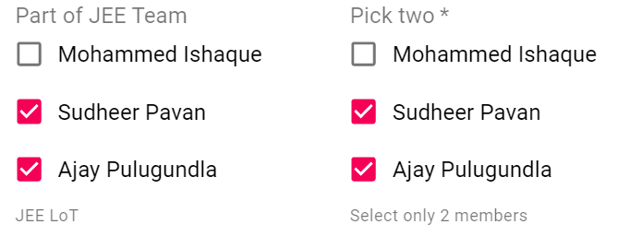
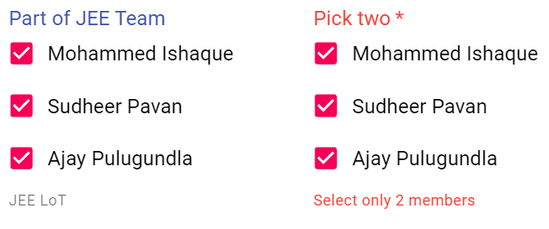
MATERIAL UI CHECKBOX FormGroup Outputs

Slide 49
MATERIAL UI GRID
Material UI's Grid layout system is mostly a wrapper around the "CSS Flexible Box module", also known as Flexbox.
MuiGrid Component name can be used for providing default props or style overrides at the theme level.
Material UI Grid's grid uses Flexbox under the hood.
The properties of Flexbox are used as properties of the Grid, so you can control the component as if it were a flexbox.
Also Material UI's Grid also provides helpers for spacing, responsive design, and fitting a 12 column layout.

Slide 50
MATERIAL UI GRID
The Material Design responsive layout grid adapts to screen size and orientation, ensuring consistency across layouts.
The grid creates visual consistency between layouts while allowing flexibility across a wide variety of designs.
Material Design’s responsive UI is based on a 12-column grid layout.
Flex Layout, which is designed for laying out more complex applications and webpages. Flex layout is used by Grid Component.
Import Statement for Grid Component is :
import Grid from '@material-ui/core/Grid';
// or
import { Grid } from '@material-ui/core';

Slide 51
MATERIAL UI GRID
How it Works:
The grid system is implemented with the Grid component:
It uses CSS’s Flexible Box module for high flexibility.
There are two types of layout: containers and items.
Item widths are set in percentages, so they’re always fluid and sized relative to their parent element.
Items have padding to create the spacing between individual items.
There are five grid breakpoints: xs, sm, md, lg, and xl.

Slide 52
MATERIAL UI GRID
<Grid container spacing={3}>
<Grid item xs={12}>
<Paper className={classes.paper}>xs=12</Paper>
</Grid>
<Grid item xs={6}>
<Paper className={classes.paper}>xs=6</Paper>
</Grid>
<Grid item xs={6}>
<Paper className={classes.paper}>xs=6</Paper>
</Grid>
<Grid item xs={3}>
<Paper className={classes.paper}>xs=3</Paper>
</Grid>
<Grid item xs={3}>
<Paper className={classes.paper}>xs=3</Paper>
</Grid>
<Grid item xs={3}>
<Paper className={classes.paper}>xs=3</Paper>
</Grid>
<Grid item xs={3}>
<Paper className={classes.paper}>xs=3</Paper>
</Grid>
</Grid>

Slide 53
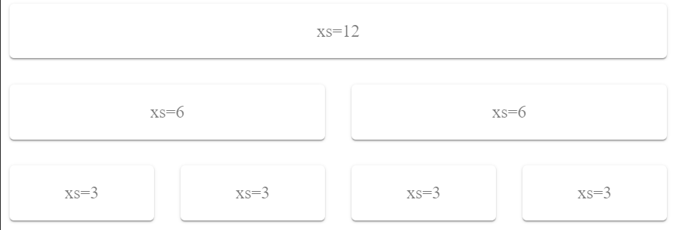
MATERIAL UI SIMPLE GRID

Slide 54
MATERIAL UI GRID with Breakpoints
<Grid container spacing={3}>
<Grid item xs={12} sm={9}>
<Paper className={classes.paper}>xs=12 sm=9</Paper>
</Grid>
<Grid item xs={12} sm={3}>
<Paper className={classes.paper}>xs=12 sm=3</Paper>
</Grid>
<Grid item xs={6} sm={3}>
<Paper cla ssName={classes.paper}>xs=6 sm=3</Paper>
</Grid>
<Grid item xs={6} sm={3}>
<Paper className={classes.paper}>xs=6 sm=3</Paper>
</Grid>
<Grid item xs={6} sm={3}>
<Paper className={classes.paper}>xs=6 sm=3</Paper>
</Grid>
<Grid item xs={6} sm={3}>
<Paper className={classes.paper}>xs=6 sm=3</Paper>
</Grid>
</Grid>
Some columns have multiple widths defined, causing the layout to change at the defined breakpoint.

Slide 55
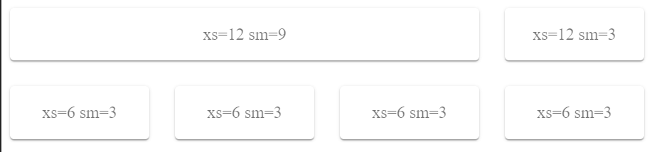
MATERIAL UI GRID with Breakpoints
A breakpoint is the range of predetermined screen sizes that have specific layout requirements.
xs (extra-small): 0px or larger
sm (small): 600px or larger
md (medium): 960px or larger
lg (large): 1280px or larger
xl (extra-large): 1920px or larger

Slide 56
Font Icons
In order to use the Font Icon component, you must first add the Material Icons font.
Material Icons are delightful, beautifully crafted symbols for common actions and items.
For instance, via Google Web Fonts:
<link rel="stylesheet"
href="https://fonts.googleapis.com/icon? family=Material+Icons">
Icon will set the correct class name for the Material icon font.
For other fonts, you must supply the class name using the Icon component's className property.
To use an icon simply wrap the icon name (font ligature) with the Icon component

Slide 57
Font Icons
For example:
import Icon from '@material-ui/core/Icon’;
<Icon>star</Icon>
Optionally, you can set the icon color using one of the theme color properties:
primary, secondary, action, error & disabled.

Slide 58
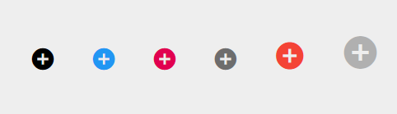
Font Material Icon
function Icons(props) {
const { classes } = props;
return (
<div className={classes.root}>
<Icon className={classes.icon}>add_circle</Icon>
<Icon className={classes.icon} color="primary">
add_circle
</Icon>
<Icon className={classes.icon} color="secondary">
add_circle
</Icon>
<Icon className={classes.icon} color="action">
add_circle
</Icon>
<Icon className={classes.iconHover} color="error" style={{ fontSize: 30 }}>
add_circle
</Icon>
<Icon className={classes.icon} color="disabled" fontSize="large">
add_circle
</Icon>
</div>
);
}

Slide 59
SVG Icons
In order to use prebuilt SVG Material icons, you must first install the
@material-ui/icons package:
npm install @material-ui/icons
Font vs SVG. Which approach to use?
Both approaches work fine, however, there are some subtle differences, especially in terms of performance and rendering quality.
Whenever possible SVG is preferred as it allows code splitting, supports more icons, renders faster and better.

Slide 60
Material UI IconButton
Material UI's IconButton is similar to the Material UI Button except it has a circular ripple designed for a single icon element.
Various Icons we can render inside IconButton.
Icon buttons are commonly found in app bars and toolbars.
Icons are also appropriate for toggle buttons that allow a single choice to be selected or deselected, such as adding or removing a star to an item.

Slide 61
Material UI IconButton Example
import React from "react";
import ReactDOM from "react-dom";
import { withStyles } from "@material-ui/core/styles";
import Typography from "@material-ui/core/Typography";
import Button from "@material-ui/core/Button";
import IconButton from "@material-ui/core/IconButton";
import SmileIcon from "@material-ui/icons/Mood";
function sayHi() {
console.log("Hello!");
}
const CustomColorIconButton = withStyles({
root: {
color: "#ff8833"
}
})(IconButton);

Slide 62
Material UI IconButton Example
function App() {
return (
<div>
<Typography variant="h5">Default IconButton</Typography>
<IconButton onClick={sayHi}>
<SmileIcon />
</IconButton>
<Typography variant="h5">Primary Color</Typography>
<IconButton color="primary" onClick={sayHi}>
<SmileIcon />
</IconButton>
<Typography variant="h5">Custom Color</Typography>
<CustomColorIconButton onClick={sayHi}>
<SmileIcon />
</CustomColorIconButton>
<Typography variant="h5">Small size</Typography>
<IconButton size="small" onClick={sayHi}>
<SmileIcon />
</IconButton>

Slide 63
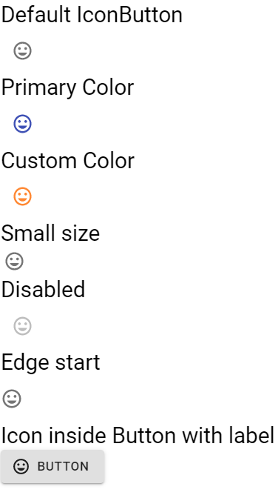
Material UI IconButton Example
<Typography variant="h5">Disabled
</Typography>
<IconButton disabled onClick={sayHi}>
<SmileIcon />
</IconButton>
<Typography variant="h5">Edge start
</Typography>
<IconButton edge="start" onClick={sayHi}>
<SmileIcon />
</IconButton>
<Typography variant="h5">Icon inside Button
with label</Typography>
<Button variant="contained"
startIcon={<SmileIcon />}>
Button
</Button>
</div>
);
}

Slide 64
Material UI Paper Component
The Paper component is a single <div> with some React props that map to CSS properties.
Most of the time we will be adding CSS via the className prop to customize the border or backgroundColor, whereas Not all CSS props are available as React Props.
To set background color on Material UI Paper, we need to apply the background-color CSS property to the root element of the Paper by using useStyles hooks.
And by default, there is no padding on the Paper component.
By using, CSS prop padding: theme.spacing(3) we can add the padding.

Slide 65
Material UI Paper Component
The Paper component does not have width or height properties.
It behaves like a normal <div> element, because that's what it is, a single <div> with a few CSS properties.
import React from "react";
import { Theme, createStyles, makeStyles } from "@material-ui/core/styles";
import Paper from "@material-ui/core/Paper";
const useStyles = makeStyles((theme: Theme) =>
createStyles({
root: {
display: "flex",
flexWrap: "wrap", "& > *": {
margin: theme.spacing(1),
width: theme.spacing(16),
height: theme.spacing(16)
} } }) );

Slide 66
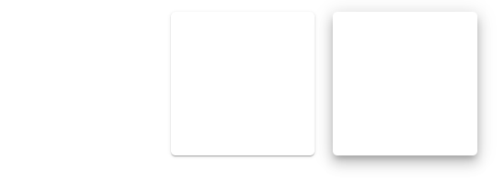
Material UI Paper Component
export default function SimplePaper() {
const classes = useStyles();
return (
<div className={classes.root}>
<Paper elevation={0} />
<Paper elevation={1} />
<Paper elevation={7} />
</div>
);
}

Slide 67
Material UI Paper Component – Other Example
const useStyles = makeStyles((theme) => ({
root: {
"& > *": {
margin: theme.spacing(1),
width: theme.spacing(32),
height: theme.spacing(16)
}
},
yellowPaper: {
backgroundColor: yellow[300]
},
customBorder: {
border: `3px solid ${yellow[200]}`
},
customBorderRadius: {
borderRadius: 25
}
}));

Slide 68
Material UI Paper Component – Other Example
<Paper>
<Typography variant="h5">Default Paper</Typography>
</Paper>
<Paper elevation={6}>
<Box p={1}>
<Typography variant="h5">Elevation</Typography>
</Box>
</Paper>
<Paper className={classes.yellowPaper}>
<Box p={1}>
<Typography variant="h5">backgroundColor</Typography>
</Box>
</Paper>
<Paper variant="outlined" square>
<Box p={1}>
<Typography variant="h5">outlined + square</Typography>
</Box>
</Paper>

Slide 69
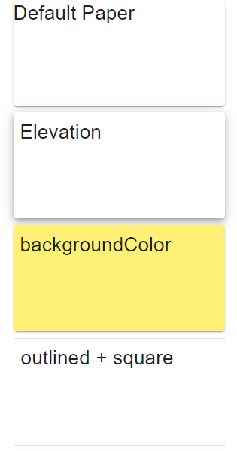
Material UI Paper Component – Output

Slide 70
Style Material UI Components with my own CSS
Material UI makes it easy to add custom CSS to any element inside any component.
You can use Material-UI's styling solution in your app, whether or not you are using Material-UI components.
const useStyles = makeStyles({
root: {
background: 'linear-gradient(45deg, #FE6B8B 30%, #FF8E53 90%)',
border: 0,
borderRadius: 3,
boxShadow: '0 3px 5px 2px rgba(255, 105, 135, .3)',
color: 'white',
height: 48,
padding: '0 30px',
},
});

Slide 71
Style Material UI Components with my own CSS
export default function Hook() {
const classes = useStyles();
return <Button className={classes.root}>Hook</Button>;
}
In above example we use makeStyles() function to generate a hook named as useStyles.
useStyles is creating the CSS classes object which contains the keys of the styles object we created.
It doesn't actually matter that we call this class root, because we reference it like a variable when we add it to the Button's className prop. <Button className={classes.root}>
It clearly shows that we can always safely overwrite the root element's CSS.

Slide 72
Style Material UI Components with my own CSS
Every component provides a className property which is always applied to the root element.
We can always safely overwrite the root element's CSS.
In previous example, we are changing the Button's background color, height, text color.
When we want to style inner HTML elements in Material UI, we can find the names of the CSS rules in the second half of the component's API page.

Slide 73
UI Templates for Business
We can build your dream React app with our modern responsive templates.
There is a selection of free react templates to help you get started building your app.
The collection contains react dashboard, react admin, and more.
So far there are demos for a dashboard, sign in page, sign up page, blog page, checkout flow, album page, pricing page, and sticky footer page.
You can access all those free templates from https://material-ui.com/getting-started/templates/

Slide 74
Typography Usage
The default <Typography> with no props will render a body1 variant, which is just a <p>.
So: <Typography> my text </Typography> is just like rendering <p> my text </p> except Material-UI will apply additional CSS.
To render an <h1>, simply pass "h1" as the variant to the <Typography component:
<Typography variant="h1">Typography h1</Typography>
In addition to changing the element's tag, Material UI will apply CSS for each typography variant.
For example, theme.typography.h1 is applied when the variant prop is "h1".

Slide 75
Typography Usage
When you want to use the color prop, you are given the typical color prop selections:
initial,
inherit,
primary,
secondary,
textPrimary,
textSecondary,
error which correspond to your theme's colors.
And to set a custom color, font-weight or other CSS for Typography, you will need a custom CSS class.
To line break with Typography, set the display prop to block, which will break the line before the text inside.
Example: <Typography display="block"> My text will be on the next line </Typography.
This may apply if you are using the overline or caption variants, which are <span> and so are normally display inline-block.

Slide 76
Summary
By now You should be clear with:
Introduction Material UI
Installing Material UI
Material UI AppBar
Material UI's Toolbar
Custom React NavBar CSS
Material UI Buttons
Using Material UI - Rendering a Button
Material UI Card
Material UI Checkbox
Material UI Grid Component
Material UI IconButton
Material UI Paper Component
Style Material UI Components with my own CSS
UI Templates for Business
Typography Usage
Notes:
Add the notes here.
Add instructor notes here.

